Slide 1
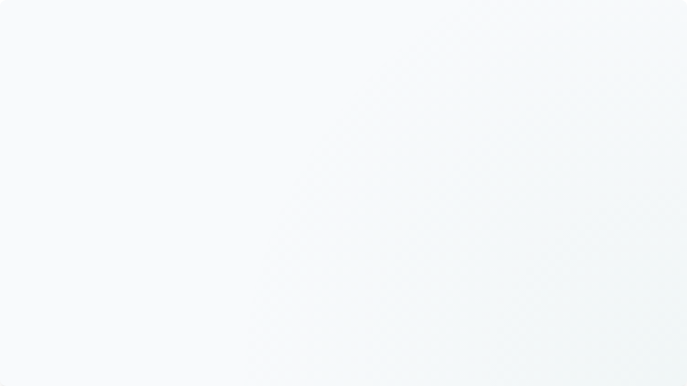


PYTHON EMAIL AUTOMATION
Python Empowers Developers to Automate Email Communication
Lecture 1: Core SMTP Connections
What We Build
Why Python
smtplib + SMTP
Lecture Objectives
A fully automated Python script to connect to mail servers and send secure emails.
Why Python is perfect for this: built-in libraries, simple syntax, and cross-platform support.
An introduction to the relationship between the Python library and the communication protocol.
• Understand SMTP
• Establish secure connections
• Authenticate with servers
• Handle connection errors
PRESENTED BY
DATE OF SESSION
Mr Muhammad Yousif
August 17, 2026

Slide 2


Email Automation Replaces Manual Tasks
Manual Email
Requires human intervention for every message sent. Creates high operational overhead and increases the risk of human error in repetitive communication tasks.
Automated Email
Handled programmatically at scale by software systems. Ensures absolute speed, reliability, and precision without requiring human oversight for each dispatch.
Real-World Applications
Attendance Notifications: Triggered instantly on database updates.
Scheduled Weekly Reports: Dispatched automatically to target users.
Registration Confirmations: Sent immediately upon user sign-up.
Critical Downtime Alerts: Broadcasted instantly to prevent disruption.
Secure Password Resets: Delivered securely when requested.
Introduction to Email Automation & SMTP | Python Basics

Slide 3
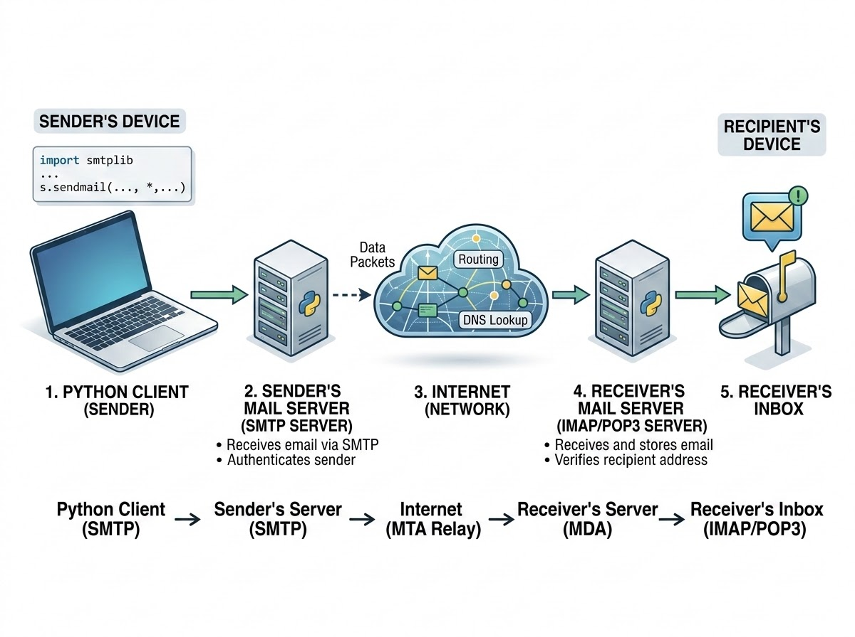
Email Transmission Relies on a Network of Clients and Servers
The journey of an email involves several interconnected systems working together.
1
The process begins with the Sender, who utilizes an Email client or application—in our case, a custom Python script. This client connects to an outgoing Mail server to hand off the message.
2
The outgoing mail server then routes the message across the Internet, locating the Receiver's mail server using specialized DNS records.
3
Finally, the Receiver accesses the delivered message through their own email client.
Project Focus
For the scope of our automation projects, we will focus on a simplified flow: the Python script generates the message, passes it to the SMTP Server, which routes it through the Internet directly to the Receiver's inbox.
Standard Email Routing Network: From Client to Receiver Inbox
Introduction to Email Automation & SMTP | Python Basics

Slide 4
SMTP: Simple Mail Transfer Protocol
Protocol Definition
SMTP (Simple Mail Transfer Protocol) is the foundational internet standard for email transmission across IP networks. The primary purpose of SMTP is exclusively for sending or routing outgoing email traffic from a client to a server, or between servers.
Sending vs. Receiving Protocols
Python's Native smtplib
SMTP pushes outgoing messages toward their destination.
Python provides smtplib, a powerful, built-in standard-library module.
Different protocols like IMAP or POP3 are required for an email inbox to retrieve and download those messages.
Specifically designed for establishing sessions and communicating with SMTP servers directly.
Introduction to Email Automation & SMTP | Python Basics

Slide 5

SMTP Servers Act as the Digital Post Office for Outgoing Messages
Dedicated Outgoing Infrastructure
An SMTP server is a dedicated computer or application responsible for receiving, routing, and delivering outgoing email messages.
Why Python Requires SMTP
Python needs an SMTP server because a local script cannot directly place an email into a remote recipient's inbox; it must hand the message off to specialized infrastructure designed for email routing.
Provider-Specific Configurations
Different providers maintain distinct SMTP addresses (e.g., smtp.gmail.com) and configurations. The Python script must target the exact SMTP server associated with the sender's account.
SMTP Protocol Role: Standardizes how email is packaged, authenticated, and hopped across servers worldwide before reaching the final recipient inbox.
Introduction to Email Automation & SMTP | Python Basics

Slide 6
Network Ports & Server Processes
A network port is a virtual endpoint where network connections start and end. Ports are strictly required to direct incoming data to the correct service, preventing SMTP email traffic from being confused with web traffic or file transfers.
Port 465 (SSL)
Port 587 (STARTTLS)
The standard port for SMTP over SSL. It establishes a secure, encrypted connection immediately before any data is transmitted.
The modern standard for SMTP with STARTTLS. It begins with an unencrypted connection and then upgrades to secure.
Beginner Recommendation: Exclusively used in initial configurations to ensure maximum security right from the start.
Opportunistic Security: Connects insecurely first and requests an upgrade. If the upgrade fails, traffic might remain unencrypted.
Introduction to Email Automation & SMTP | Python Basics

Slide 7

SSL and TLS Encryption Protect Sensitive Email Credentials from Interception
Protecting email credentials during automation is a critical security requirement.
Transmitting passwords over an unencrypted connection exposes them to network eavesdropping, whereas an encrypted connection scrambles the data, making it unreadable to interceptors.
This security is achieved through SSL (Secure Sockets Layer) and its modern successor TLS (Transport Layer Security), which are cryptographic protocols designed to secure communications over a network. In Python, utilizing the SMTP_SSL() class guarantees that the connection is encrypted from the very first byte.
Following industry best practices, tutorials recommend establishing this encrypted SMTP connection by combining ssl.create_default_context()—which loads trusted system certificates—with the SMTP_SSL() command for robust security.
Introduction to Email Automation & SMTP | Python Basics

Slide 8
The smtplib Module
To begin automating emails, we introduce the import smtplib statement.
Core Module Concept
In Python, a module is a file containing Python definitions and statements that allow developers to reuse pre-written code.
The smtplib module is a powerful tool included in Python's standard library that defines an SMTP client session object.
Networking Capabilities
Seamlessly connect to SMTP servers
Manage secure authentication processes
Route emails to their final destinations
Abstract complex underlying socket connections
Focus entirely on connecting and transmitting data
Introduction to Email Automation & SMTP | Python Basics

Slide 9
Establishing a Secure Connection Requires the Server Address and Port
server = smtplib.SMTP_SSL("smtp.gmail.com", 465)
smtplib (Library Call) The smtplib call references the imported library.
SMTP_SSL (Security Class) The SMTP_SSL class is instantiated to guarantee that the connection is encrypted securely from the moment it opens.
"smtp.gmail.com" (Server Address) The Server address specifies the exact domain name of the email provider's outgoing mail infrastructure.
465 (Numerical Port) Finally, the Port directs the traffic to the designated numerical endpoint for secure SMTP communication.
Pipeline:Together, these elements open a dedicated, encrypted pipeline between the local Python script and the remote mail server.
Introduction to Email Automation & SMTP | Python Basics

Slide 10
Secure Authentication Verifies Sender Identity Using App Passwords
server.login(sender_email, password)
SECURITY PRACTICE
Protect Primary Credentials
SMTP Authentication & Security
Developers should always utilize a dedicated testing account equipped with Two-Factor Authentication (2FA) and a specific App Password, rather than exposing primary personal credentials within plaintext scripts.
Sender Verification: Once connected, the sender email acts as the username, and authentication proves your identity to the server.
Secure App Passwords
Spam Prevention: Credentials are strictly required because SMTP servers must prevent unauthorized users from utilizing legitimate domains.
Providers utilize specially generated, single-use passwords that securely bypass standard login screens and 2FA prompts.
Introduction to Email Automation & SMTP | Python Basics

Slide 11
CONNECT
AUTHENTICATE
CLOSE
Secure Connection & Authentication Flow
This live coding demonstration highlights the fundamental connection lifecycle.
PYTHON SMTP_SSL IMPLEMENTATION
import smtplib
import ssl
context = ssl.create_default_context()
with smtplib.SMTP_SSL("smtp.gmail.com", 465, context=context) as server:
server.login(sender_email, password)
print("Connected successfully!")
Secure Environment & Lifecycle
The script imports smtplib and ssl, then creates a secure environment using context = ssl.create_default_context(). The with statement is utilized alongside smtplib.SMTP_SSL to ensure the network connection is automatically and safely closed after execution.
Authentication Flow
Inside this block, server.login() authenticates the user, followed by a success print statement. The focus here is entirely on the core mechanics: initiating the Connect phase, successfully completing Authenticate, and ensuring a clean Close without sending an email yet.
Introduction to Email Automation & SMTP | Python Basics

Slide 12
Build & Verify First Secure SMTP Connection
Lecture 1 Mini Task
Students will create a functional Python program from scratch that validates their environment setup.
warning
Task Safety Constraint
Note: Do not attempt to send an email during this task. The objective is to establish a clear endpoint for Lecture 1 by mastering the connection and authentication mechanics first.
Imports smtplib to access the networking tools.
Creates an SSL context to guarantee connection security.
Connects to Gmail SMTP using the correct server address and port.
smtp_verify.py
Logs in using the student's designated testing email and App Password.
# Run verification script
$ python smtp_verify.py
# Expected terminal output:
SMTP Login Successful
Prints "SMTP Login Successful" to the console upon completion.
Introduction to Email Automation & SMTP | Python Basics

Slide 13
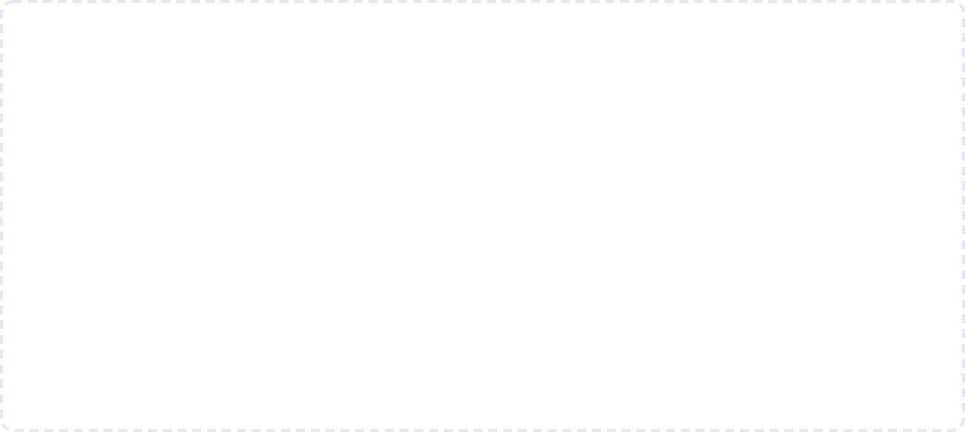
Sending an Email Requires Constructing a Message
Before Transmission
Lecture 1 Revision: Let's perform a quick revision of the workflow established in the previous session. The execution begins with Python, which initiates a connection to the SMTP Server. Once connected, the script performs Authentication to verify identity.
Lecture 2 Transition: To bridge the gap, we must introduce the critical next phase: Create Email. Before any data can be transmitted, the actual email payload must be meticulously constructed. Only after the message object is built can we execute Send Email.
Lecture 1 Revision
Lecture 2 Transition (New Milestone)
1
2
3
4
5
Python Script
The script execution begins, launching the automated email flow.
SMTP Server
Initiates a secure connection to the designated SMTP server.
Authenticate
Performs secure login protocols to verify connection identity.
Create Email
Meticulously constructs and formats the email payload standards.
New Bridge
Send Email
Executes the final command to transmit content to recipient.
Introduction to Email Automation & SMTP | Python Basics

Slide 14
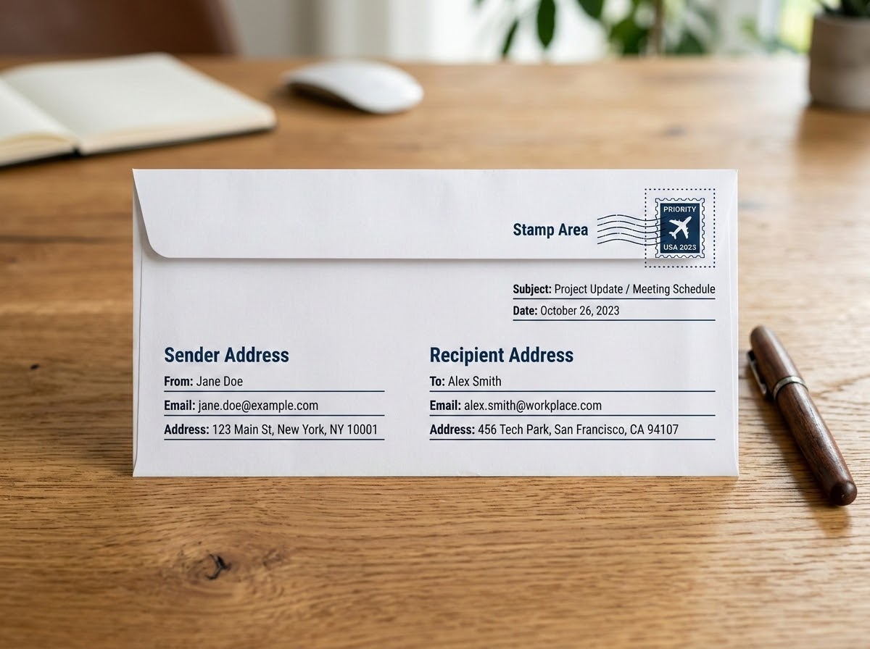
Standard Emails Consist of Structured Headers and a Main Body
To build an email programmatically, we must understand its basic anatomy. Every standard email is divided into structured components.
Routing Headers (Metadata)
From: teacher@gmail.com (Sender's address)
To: student@gmail.com (Recipient's destination)
Subject: Python Assignment (Content summary)
Email Body (Payload)
"Hello Student, Your assignment has been received."
Understanding this strict separation between headers and body is crucial for proper programmatic construction.
Physical Envelope Analogy: Mapping Sender, Recipient, and Content Payload
Introduction to Email Automation & SMTP | Python Basics

Slide 15
The Email Package Constructs the Message Payload for Transmission
To construct our message, we introduce a new tool: from email.message import EmailMessage
The email Package
The Letter & Envelope (Data Layer)
The smtplib Module
The Postal Service (Network Layer)
Responsible for the data layer. It is responsible for creating, formatting, and structuring the actual email message content.
Responsible for the network layer. It communicates with SMTP servers to deliver the package over the internet.
Acts as the digital envelope and letter
Acts as the postal service to physically handle sending
Sets up message content, headers, and body structure
Manages SMTP server connection, auth, and routing
Introduction to Email Automation & SMTP | Python Basics

Slide 16
Instantiating an EmailMessage Object
PROGRAMMING CONCEPT
PYTHON INSTANTIATION
“An object is a specific instance of a class that holds structured data and the methods required to manipulate that data.”
# Create a blank, structured container
msg = EmailMessage()
The foundation of our message construction is the instantiation of the empty object container.
By instantiating msg, we generate an empty digital envelope where we can systematically attach our routing headers, subjects, and body text before delivery.
In Python, the EmailMessage is a specialized class designed to represent an email in memory, automatically handling complex internet formatting rules.
Introduction to Email Automation & SMTP | Python Basics

Slide 17
Dictionary Syntax Assigns Critical Routing Information to the Message Headers
# Populate header fields
msg["From"] = sender_email
msg["To"] = receiver_email
msg["Subject"] = "My First Python Email"
Header Key-Value Bindings
Python abstracts low-level RFC formatting into clean, intuitive key-value assignments:
"From" Key
Defines the origin address (sender_email)
The EmailMessage object utilizes a dictionary-style syntax, allowing developers to set header fields using intuitive key-value pair assignments.
This straightforward syntax abstracts away the complex string formatting normally required by raw SMTP protocols, making it simple and reliable to build routing information.
"To" Key
Defines the destination address (receiver_email)
"Subject" Key
Defines the email title ("My First Python Email")
Introduction to Email Automation & SMTP | Python Basics

Slide 18
The set_content() Method
Code Implementation
msg.set_content(
"Hello! This email was sent..."
)
Method Anatomy
Plain-Text Standard
Structure & Delivery
msg: The EmailMessage object instance
Built-In Body Injection Designed specifically to safely inject text into the body of the EmailMessage object.
Universal Compatibility Highly compatible across all modern devices and significantly less likely to trigger aggressive spam filters.
set_content(): Method to safely inject body
Plain-Text Standard Creates a clean email containing only unformatted characters without any complex HTML styling.
Structural Distinction Dictionary syntax handles the metadata headers, while the set_content() method is used exclusively for the main body.
"Hello!...": The plain-text message string
Introduction to Email Automation & SMTP | Python Basics

Slide 19
The send_message Command
CREATE
Create message object and populate its headers and body.
ACTIVE COMMAND
server.send_message(msg)
The final step in our execution is the command above. This single line represents the culmination of the complete sequence, successfully bridging the message construction phase with the server communication phase.
It ensures that all headers, attachments, and payloads are fully transmitted to the designated SMTP server before connection closure.
01
CONNECT
Connect to the designated SMTP server securely.
02
LOGIN
Execute the login process to authenticate credentials.
03
SEND (ACTIVE)
Utilizes send_message to transmit the constructed object.
04
CLOSE
Close the connection to free up system resources.
05
Introduction to Email Automation & SMTP | Python Basics

Slide 20
Combining the Libraries Yields a Fully Functional Email Automation Script
email_automation.py
import smtplib
import ssl
from email.message import EmailMessage
sender_email = "sender@gmail.com"
receiver_email = "receiver@gmail.com"
msg = EmailMessage()
msg["From"] = sender_email
msg["To"] = receiver_email
msg["Subject"] = "Python Test Email"
msg.set_content("Hello! This email was sent using Python.")
context = ssl.create_default_context()
with smtplib.SMTP_SSL("smtp.gmail.com", 465, context=context) as server:
server.login(sender_email, password)
server.send_message(msg)
print("Email sent successfully!")
Introduction to Email Automation & SMTP | Python Basics

Slide 21
Four Stages of Script Execution
STAGE 01
STAGE 02
Import Libraries
Create Email
Bringing in smtplib, ssl, and EmailMessage to access necessary networking and formatting tools.
Instantiating the object, utilizing dictionary syntax for headers, and setting the body content.
STAGE 03
STAGE 04
Connect & Login
Send Email
Establishing a secure SSL context, opening the connection to the SMTP server, and authenticating credentials.
Transmitting the constructed payload via send_message() and allowing the context manager to close the connection.
Introduction to Email Automation & SMTP | Python Basics

Slide 22
Try-Except Blocks Prevent Crashes
Python Try-Except Structure
Common Automation Failures
try:
# email execution code
print("Email sent!")
except Exception as e:
print("Error:", e)
Proper exception handling is critical for diagnosing these common beginner errors in network automation:
Wrong Email Formatting: Syntax or spelling mistakes in sender or recipient addresses.
Invalid App Password: Utilizing standard passwords instead of app-specific credentials.
Wrapping execution code in a try block attempts the operation, while the except block gracefully catches and prints errors instead of crashing the script.
SMTP Port Blocking: Connection failures due to ISPs or firewalls blocking secure ports.
Network Connectivity: General internet dropouts disrupting the mail server handshake.
Introduction to Email Automation & SMTP | Python Basics

Slide 23
Mini Project: Student Email Sender
Objective: Build an interactive script that prompts users for dynamic email details, structures the message payload, and securely transmits it using SMTP protocols.
01
02
03
01 / DATA CAPTURE
Input & Variables
Capture dynamic receiver email using Python's input().
Collect custom subject lines and message body text.
Store and synthesize dynamic inputs safely using Variables.
02 / EMAIL MESSAGE
SMTP & Structure
Structure dynamic input data within an EmailMessage.
Establish secure connections using Python's smtplib.
Handle secure SMTP authentication with credentials.
03 / STABLE DELIVERY
Send & Stability
Execute the send_message() sequence for transmission.
Wrap network and sending operations in try/except blocks.
Ensure overall script robustness and error handling.
Introduction of Electronics | Robotics and Automation Systems

Slide 24
Mastering SMTP Fundamentals Unlocks Advanced Email Automation Capabilities
Learned SMTP Concepts
A solid grasp of these core components prepares you for advanced scripting:
What's Next? Future Pathways
Expand your automation toolkit to build enterprise-ready solutions:
SMTP & Server
EmailMessage
1
Rich Emails: Send styled HTML layouts and programmatically include file Attachments.
Ports & SSL/TLS
Headers & Body
2
Smart Distribution: Utilize CC / BCC routing and distribute to Multiple Recipients simultaneously.
smtplib library
send_message()
Authentication
Exception Handling
3
Systems Integration: Generate Automated Reports or integrate with Django frameworks.
8 SMTP CONCEPTS MASTERED
For further pathways, reference the Real Python tutorial series.
Introduction to Email Automation & SMTP | Python Advanced

